Slide 1
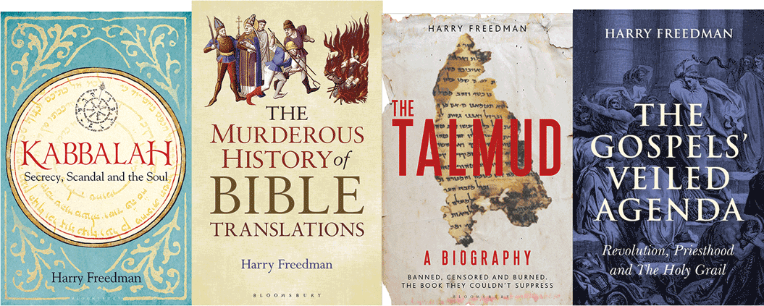
Who Wrote the Zohar?
Harry Freedman www.harryfreedmanbooks.com

Slide 2
R. Yehuda, R. Yose and Rabbi Shimon were sitting, and Yehuda, son of converts, sat beside them. R. Yehuda said: How pleasant are the actions of this nation, the Romans, as they established marketplaces, established bridges, and established bathhouses. R. Yose was silent. R. Shimon ben Yoḥai said: Everything that they established, they established only for their own purposes. They established marketplaces, to place prostitutes in them; bathhouses, to pamper themselves; and bridges, to collect taxes from all who pass over them. Yehuda, son of converts, went and related their statements and they were heard by the monarchy. They said: Yehuda, who elevated the Roman regime, shall be elevated. Yose, who remained silent, shall be exiled to the city of. And Shimon, who denounced the government, shall be killed.
R. Shimon and his son Rabbi Elazar ... hid in a cave. A miracle occurred and a carob tree was created and a spring of water. They would remove their clothes and sit in sand up to their necks. They would study Torah all day. At the time of prayer, they would dress, cover themselves, and pray, and they would again remove their clothes afterward so that they would not become tattered. They sat in the cave for twelve years. Elijah came and stood at the entrance to the cave and said: Who will inform bar Yoḥai that the emperor died and his decree has been abrogated?
They emerged and saw people who were ploughing and sowing. He said: These people abandon eternal life of Torah study and engage in temporal life for their own sustenance. Every place that they directed their eyes was immediately burned. A Divine Voice emerged and said to them: Did you emerge to destroy My world? Return to your cave. They again went and sat there for twelve months. They said: The judgment of the wicked in Gehenna lasts for twelve months.. A Divine Voice emerged and said to them: Emerge from your cave. They emerged. Everywhere that Rabbi Elazar would strike, Rabbi Shimon would heal. Shabbat 33b
Harry Freedman www.harryfreedmanbooks.com

Slide 3
Rabbi Pinḥas used to visit Rabbi Reḥumai by the shore of Lake Kinneret. He was a venerable man, full of days and his eyes could no longer see. He said to Rabbi Pinḥas: I have had a trustworthy report that our companion bar Yoḥai has a jewel, a precious gem and I have looked upon the light emitted by this jewel and it is like the light of the sun emerging from its sheath, illuminating the entire world. This light extends from the heavens to the earth, and will continue to illumine the whole world until the Ancient of Days comes and sits upon the throne...
… Go my son, go and follow this jewel which illumines the world, for the hour is now ripe for you. He left him and prepared to go on board a ship with two other men. He saw two birds, darting low over the lake. He called to them and said ‘Birds, birds, darting low over the lake, have you seen where bar Yoḥai is?’ He waited a little. ‘Birds, birds,’ he said, ‘go and come back to me.’ And they flew away. They embarked and set off across the lake. Before they had disembarked the birds returned and in the mouth of one of them was a message that said that bar Yoḥai had left the cave, together with Rabbi Eliezer, his son. He went to him and found him transformed, for his body was covered with mould. He wept and said ‘Alas, that I should see you so!’ He replied: ‘Blessed is your portion in that you have seen me so, for had you not seen me in this state, I would not be in this state.’ Zohar 1, 11a–11b
Harry Freedman www.harryfreedmanbooks.com

Slide 4
R. Shimon said: All the luminaries, the companions of this holy circle, the highest of the high heavens and the supernal of the supernal holy earth are my witnesses that I see now what no one has seen since Moses ascended Mount Sinai for the second time...And more I know that my face shines and Moses did not know.... Zohar iii 132b
Once there was a plague in Lod. R. Shimon bar Yohai came to the city. They said to R. Shimon, ‘What shall we do?’ He got up and walked though the city and saw people dying. He said: Is all this happening in the city while I am here? I decree it to stop. They heard a divine voice saying ‘Get out of here, since R.Shimon bar Yohai is here and what the Holy One blessed be he decrees, he annuls Zohar Hadash 85c
Then Moses said to Aaron: Take the fire pan and put on it fire from the altar and add incnense (Num 17,11), and it is written ‘And Aaron took fire etc. (17,12). And it is written ‘And the plague had begun among the peoe (17,13). And it is written ‘He stood between the dead and the living until the plague was stopped. (17,13). Moses did it through labour while R. Shimon did it through speech. The Holy One blessed be he decrees, and R. Shimon annuls the plague. Zohar Hadash 85d
Harry Freedman www.harryfreedmanbooks.com

Slide 5
Rabbi Isaac went to Spain to find out how the book of the Zohar which Rabbi Simeon and his son, Rabbi Eleazar, composed in the cave came to exist in his time. This is what he says:
Since I saw that its words were wonderful, drawn from the celestial source...I pursued it and asked the scholars who possessed some of its great words of wisdom whence had come these wonderful mysteries that had been transmitted orally... And I did not find their answers to my question very convincing. Some said one thing and some said another. Some said in answer to my question that the faithful Rabbi Nachmanides had sent it from Israel to the land of Catalonia, to his son, and the wind had brought it to Aragon and it had fallen into the hands of the sage Rabbi Moses de Leon.... Some said that Rabi Simeon ben Yohai did not write the book at all, but that this Rabbi Moses knew the Holy Name and through its power wrote these wonderful words, and in order to sell them for a good price, for much silver and gold, he ascribed them to our great ancestors saying: I have transcribed for you these words from the book composed by Rabbi Simeon ben Yohai and his son, Rabbi Eleazar.
Harry Freedman www.harryfreedmanbooks.com

Slide 6
When I came to Spain I found Rabbi Moses there, and he liked me and spoke with me, and swore: 'may God do so to me, and more also, if there is not at this moment in my house, where I live in Avila, the ancient book written by Rabbi Simeon ben Yohai, and when you come to see me there I shall show it to you. Rabbi Moses left me after this and went to Arevalo on his way home to Avila, but he fell ill in Arevalo and died there. When I heard the news I was furious, and resumed my journey and came to Avila. There I found a great and venerable scholar named Rabbi David de Pancorbo and we got on well together and I adjured him, saying: 'Do you know the mysteries of the Zohar, about which people are divided, some saying one thing, and some another?... And he said: 'Know for sure that it is clear to me without a doubt that the Zohar was never in Rabbi Moses' possession, and in fact has never existed. But Rabbi Moses was a master of the Holy Name, and whatever he wrote in this book he wrote through its power. And now, listen how it is that I know all this.
Rabbi Moses was a great spendthrift and would part with his money very easily.... Now, when the news reached us that he had died in Arevalo, I went to call on a prominent wealthy man who lived in this city, by the name of Rabbi Joseph de Avila.... I suggested that this Rabbi Joseph should summon his wife and tell her to send a servant with a present for the wife of Rabbi Moses. And this she did. And on the next day he said to her: Now go to the house of Rabbi Moses' wife and say as follows: I should very much like my son to marry your daughter, and then you will never lack bread to eat or clothes to wear. And I require nothing at all from you except the book of the Zohar from which your husband used to copy extracts for people. You shall say this [continued Rabbi Joseph] to both the mother and the daughter separately, and listen carefully to what each one says to see if their replies tally. And she did as she was asked.
Harry Freedman www.harryfreedmanbooks.com

Slide 7
And Rabbi Moses' wife replied to Rabbi Joseph's wife on oath, saying: May God do so to me and more also if my husband ever possessed such a book. But he wrote what he did out of his own head and heart, and knowledge and mind. And when I saw him writing without any material before him I used to say to him: Why do you tell everybody that you are copying from a book, when you have no book, and you write out of your own head? Would it not be better for you to say that the work was your own brainchild, because then you would get more credit? And he would reply: If I told them my secret and that what I wrote was my own invention, they would pay no heed to my words, and would not give me a penny for them, because they would say that I had made it all up.
Harry Freedman www.harryfreedmanbooks.com

Slide 8
Some Manuscript Components of the Zohar
and when they were first quoted
14th Century
  Midrash Ha Ne’elam
  Idra Rabba
  Idra Zuta
  Sefer Shivat HaHechalot
  Sitrei Torah
  Sitrei Otiyot
  Sifra Ditseniuta
15th Century
  Tikunei Hazohar
16th Century
  Ra’aya Mehemna
Harry Freedman www.harryfreedmanbooks.com

Slide 9
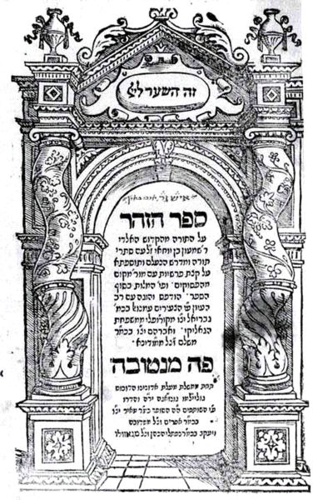
First Printed Editions of the Zohar
Tikkunei Hazohar- Mantua 1557
Zohar- Mantua 1558-60
Cremona 1559-60
Zohar Hadash Salonika 1597
Harry Freedman www.harryfreedmanbooks.com

